Slide 1

Event Management and Booking System
Easy and Comfortable event planning with our web application.
Team Members -
ISHU
KISHAN BATRA (2300290140090)
MAYANK SAINI
DEEPRAJ SINGH

Slide 2
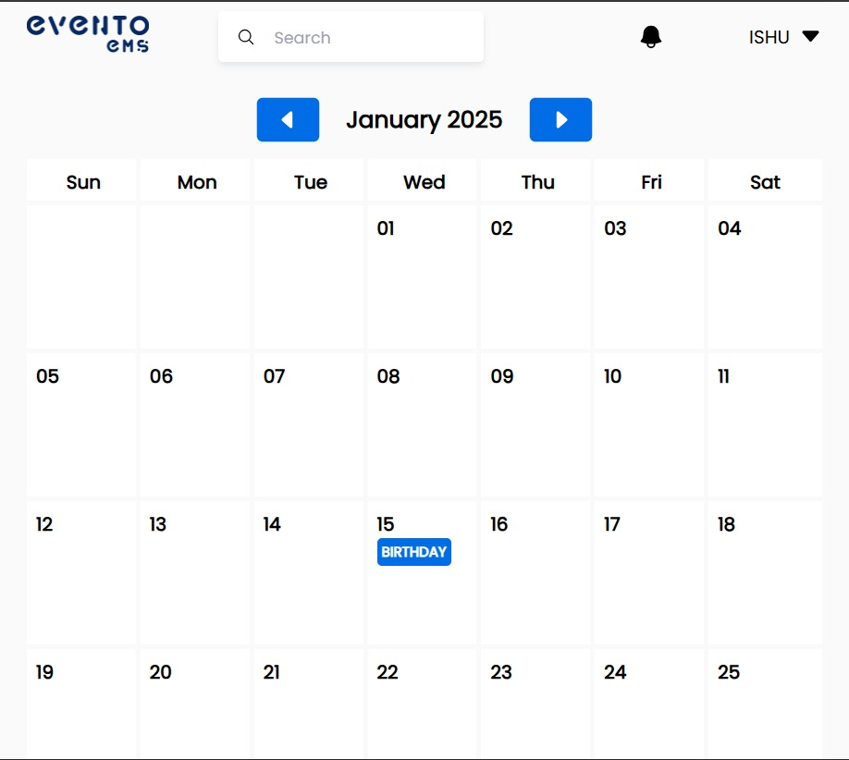
Project Abstract
Simplifies event planning using a user-friendly web app.
Project Overview
Key Objectives
A MERN Stack Based Project for Booking and Organizing Events
Efficient Management
User-Friendly Interface
Comprehensive Services
Approach
Allows users to choose the Type of Event, date and manage it accordingly

Slide 3

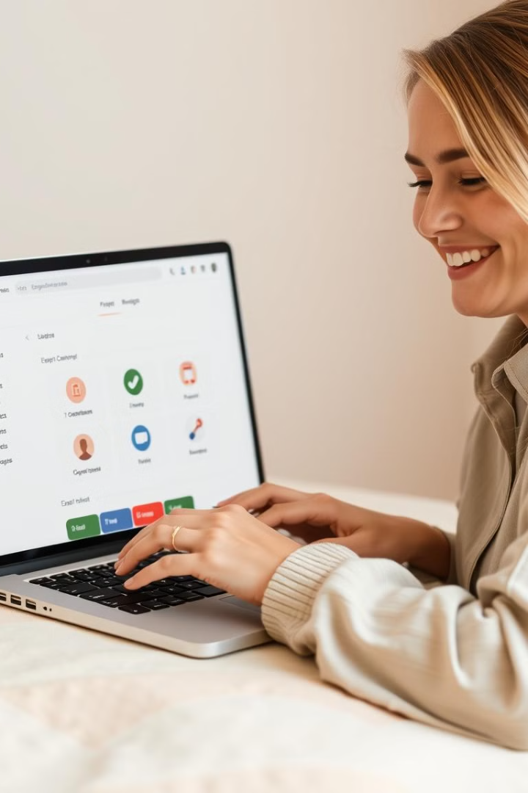
Key Project Objectives
Ensure an enjoyable user experience.
1
User-Friendly Interface
2
Comprehensive Services
Seamless and interactive user experience.
Cover various event types, from birthdays to outings.
3
Efficient Management
4
Secure Data Storage
Protect user information with secure data storage.
Streamlined tracking and management for event organizers.

Slide 4
Technology Stack and Approach
Utilize a robust and dynamic technology stack.
MERN Stack
User Interface
Functionality
MongoDB, Express.js, React, Node.js.
Aesthetic and engaging design with a focus on usability.
Integrate services, contact forms, and interactive elements.

Slide 5
Project Goals and Objectives
Ensure a scalable and sustainable solution.
1
Scalable Solution
2
Customer Satisfaction
Future growth and integration of new features.
Enhance customer experience with user-friendly navigation.
3
Operational Efficiency
4
Data Security
Implement strong security measures to protect user data.
Improve event management efficiency for both users and administrators.

Slide 6
Methodology and Approach
Leverage a comprehensive and well-defined methodology.
1
Front-End Development
React.js for a responsive and dynamic interface.
2
Back-End Development
Node.js and Express.js for RESTful APIs.
3
Database Management
MongoDB for secure data storage and retrieval.
4
User Interface Design
Focus on user-friendly and engaging aesthetics.

Slide 7
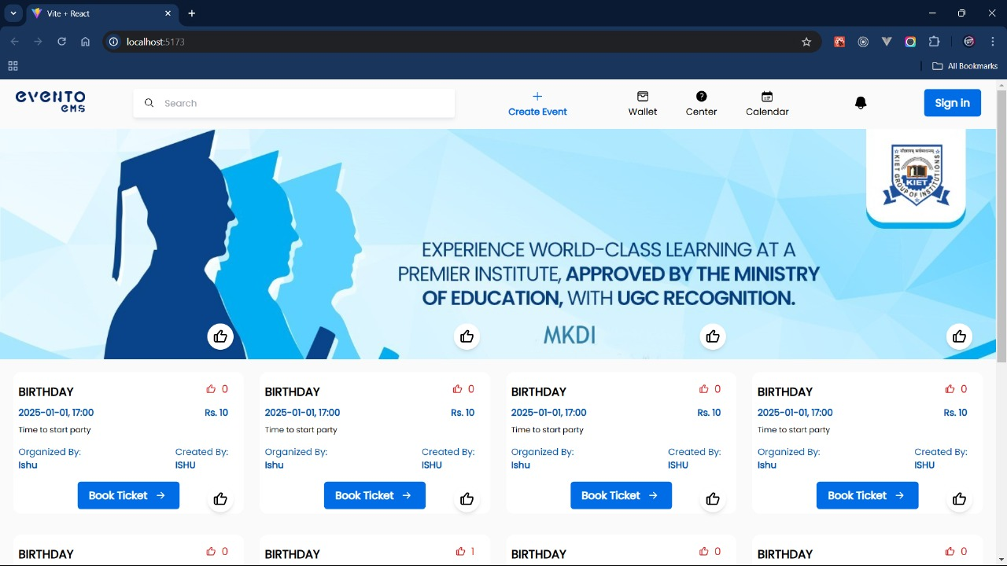
Expected Outcomes and Impact
Deliver a transformative user experience.
1
Enhanced User Experience
2
Efficient Event Coordination
Simplified booking and management for users.
Streamlined management system for event planners.
3
Improved Accessibility
Mobile-friendly design ensures accessibility across devices.

Slide 8
Key Project Deliverables
Deliver a comprehensive suite of features.
User Interface
Service Offerings
Interactive Contact Form
Clean, organized layout with easy booking and contact.
Birthday parties, anniversaries, camping, and gatherings.
Easy-to-use form for communication with clients.

Slide 9



Next Steps and Conclusion
Continuously evolve and improve the application.
Scale and Expand
Plan for additional services like weddings and corporate events.
Enhanced Features
Integrate real-time chat support, detailed scheduling, and notifications.
Feedback and Improvement
Gather user feedback and make iterative improvements.

Slide 10
THANK YOU

